Slide 1
Object-Oriented Programming
Mr. Ali Haider
Lab Instructor
School of CS & IT
Institute of Management Sciences, Peshawar, Pakistan

Slide 2
Previous lecture
A simple analogy
A class is a blue print e.g. car engineering drawing
An object has existence e.g. my car
Each object has its attributes (variables) and behavior (functions)
To perform a task describe by class, an object of that class must be created

Slide 3
Today’s Lecture
Simple C++ program using cin and cout
Member function with parameters/arguments
Setter functions and getter functions

Slide 4
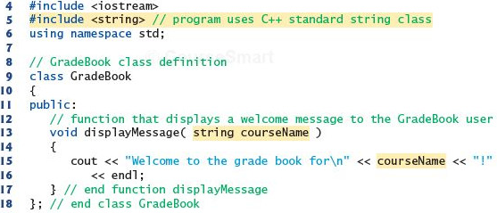
Member function with parameter

Slide 5
Access Specifier
Access specifiers control the visibility/accessibility of class members (data and methods) - i.e., who can access what.
Three main access specifiers (in C++):
Private
Accessible only within the same class.
Not accessible outside the class or by derived classes.
Default access specifier for a class in C++.
Public
Accessible from anywhere - inside the class, outside the class, and by derived classes.
Protected
Accessible within the same class and by derived (child) classes.
Not accessible from outside the class directly.
Why use them? This supports Encapsulation - hiding internal implementation details and only exposing what's necessary, protecting data from unwanted external access/modification.

Slide 6
Setter and Getter Functions
These are public methods used to safely access and modify private data members of a class - a core technique for implementing encapsulation.
Getter – retrieves (reads) the value of a private variable.
Setter – modifies (updates) the value of a private variable, often with validation.
Why not just make the variable public? Because that would let anyone change it directly, without any checks - e.g., someone could set a student's marks = -50 or an age to -10. Setters let you validate input before accepting it. Getters let you control how data is exposed (e.g., read-only).
Naming convention: usually getX() and setX().

Slide 7

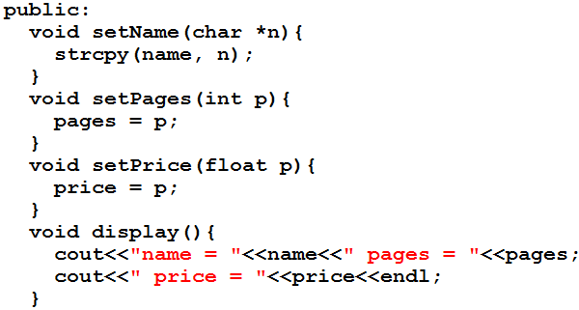
A book class

Slide 8


Class data
The class Book contain three data items
char name[15];
int pages;
float price;
There can be any number of data members in a class just as in structure
Data member are after the keyword private, so they can be accessed from within the class, but not outside

Slide 9
Member function
These functions are included in a class
There are four member functions in class Book
setName(char *n)
setPages(int p)
setPrice(float p)
display()
These functions are followed by a keyword public, so they can be accessed outside the class

Slide 10
Class data and member function
Access specifier label public and private
Function are public and data is private
Data is hidden so that it can be safe from accidental manipulation
Functions operates on data are public so they can be accessed from outside the class

Slide 11
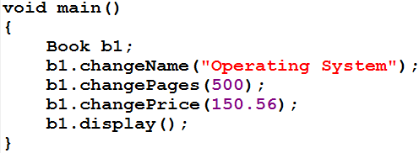



Defining Objects
b1
name
Operating system
pages
500
price
150.56

Slide 12
Continued….
Defining an object is similar to defining a variable of any data type: Space is set aside for it in memory e.g. int x;
Defining objects in this way (book b1;) means creating them
An object is an instance (that is, a specific example) of a class. Objects are sometimes called instance variables.

Slide 13
Calling Member Functions
The next four statements in main() call the member function
b1.setName("Operating System");
b1.setPages(500);
b1.setPrice(150.56);
b1.display();
don’t look like normal function calls
This syntax is used to call a member function that is associated with a specific object
It doesn’t make sense to say
changeName("Operating System");
because a member function is always called to act on a specific object, not on the class in general

Slide 14
Cont.
To use a member function, the dot operator (the period) connects the object name and the member function.
The syntax is similar to the way we refer to structure members, but the parentheses signal that we’re executing a member function rather than referring to a data item.
The dot operator is also called the class member access operator.
Programming implementation of the previous program

Slide 15
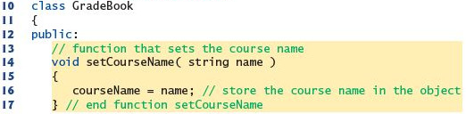

Data members, set and get functions

Slide 16
Enough for Today

Slide 17
Any Questions?

Slide 18
Thank You

